Slide 1

Static Dynamic Analyzer Tool
Presented by…….
Sudha Singh (TL)
Rutuja Navghare
Shikha Mishra
Jayashree Mishra
Kirti Singh
Komal Matsagar

Slide 2

About the Project
The objective of the project is generating a report based on the results of the splint analysis and the report should include a summary of the number of warnings and errors as well as the details about each and individual errors. It captures the output from the splint and parse it to extract any warnings or errors that were reported.It should also run makefile, capture the warnings and errors if any, and generate executable if possible and generate report.It should also run the executable with given arguments if any with valgrind, capture output and generate the valgrind report.

Slide 3

Introduction to Static Dynamic Analyser Tool
A Static Dynamic Analysis Tool is a program that analyzes the .c file’s code at the time of executions but without executing .c files. This can be useful for identifying potential issues in code such as syntax errors, security vulnerabilities or code that does not adhere to coding standards. On the other hand it also check memory leak using Valgrind tool. It also reduce the time compilation by using Makefile functionality.

Slide 4




MAJOR SYSTEM REQUIR-EMENTS
C++ Programming
LINUX OS
UBUNTU

Slide 5
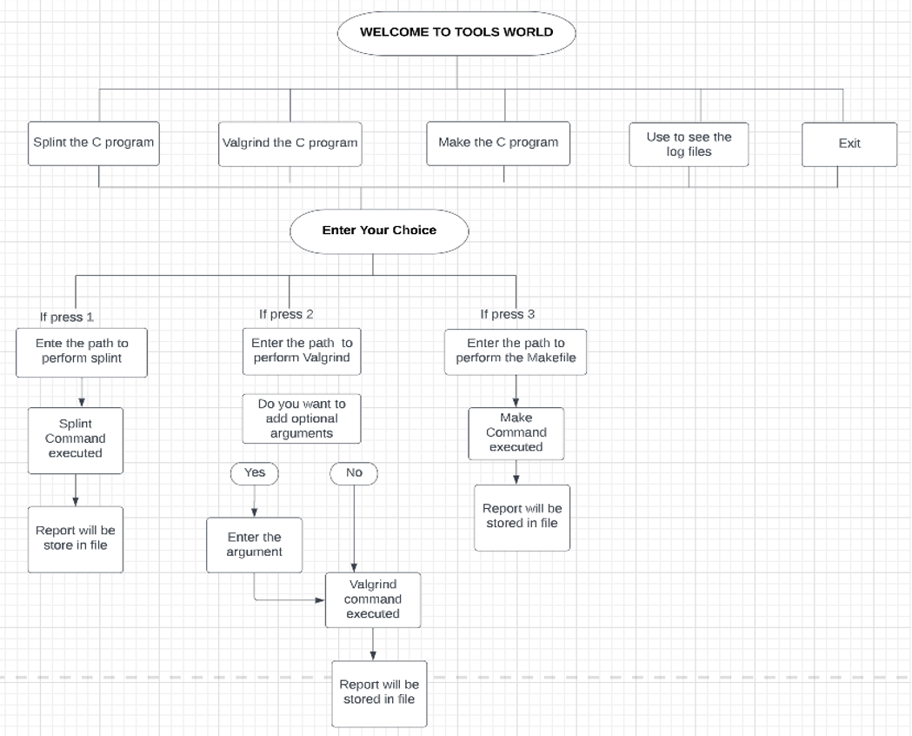

Slide 6
Use of Splint in SDAT
In static analysis, splint can be used to identify issues such as null pointer dereferences, and uninitialized variables. It can also detect problems with code formatting and style and suggest improvements to make the code more readable and maintainable.
It is a static analysis tool that is used to identify potential errors and security vulnerabilities in C programs. It works by analyzing the source code of a program and identifying areas that may be prone to errors or security issues.
In Overall splint is a useful tool for improving the quality and security of source code as part of the SDAT. It can help developers identify and fix issues before they become problems in the final product.

Slide 7
Use of Valgrind in SDAT
Valgrind can be used to perform dynamic analysis on the source code being examined. By executing the code and monitoring its behavior. It can be helps to identify issues that may not be visible during static analysis. Example for race conditions or other concurrency-related problems.
Valgrind can also be used to perform performance analysis, such as measuring the amount of memory used by a program or identifying hotspots in the code that may be causing performance issues.
Valgrind is a useful tool for improving the quality and the performance of source code as part of the SDAT. It helps developers to identify and fix the issues before they become problems in the final product.

Slide 8
Use of Makefile in SDAT
Makefile is a script that can be used to automate the process of building and testing the source code being examined. Makefiles typically specify a set of rules that describe how to build the code, including dependencies between different source files and how to invoke the compiler and other tools.
Makefiles can be used to simplify the process of building and testing the source code, particularly in large projects with many source files and dependencies. They can also help ensure that the build process is consistent and repeatable, making it easier to reproduce the results of the static and dynamic analysis performed by the SDAT.
Overall, Makefiles can be a useful tool for automating and streamlining the process of building and testing source code as part of the SDAT.

Slide 9
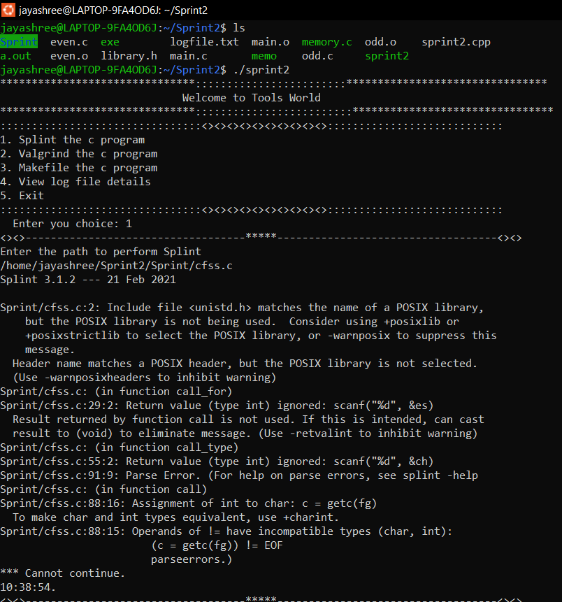
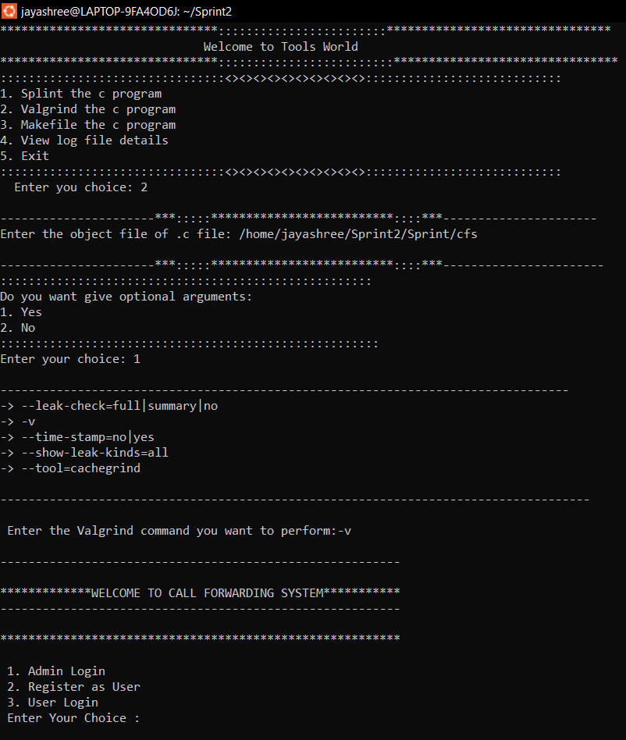
Able to run Tools Splint, Valgrind using a directory base path.
Search .c files in the given directory and capture the result in different txt file.

Slide 10
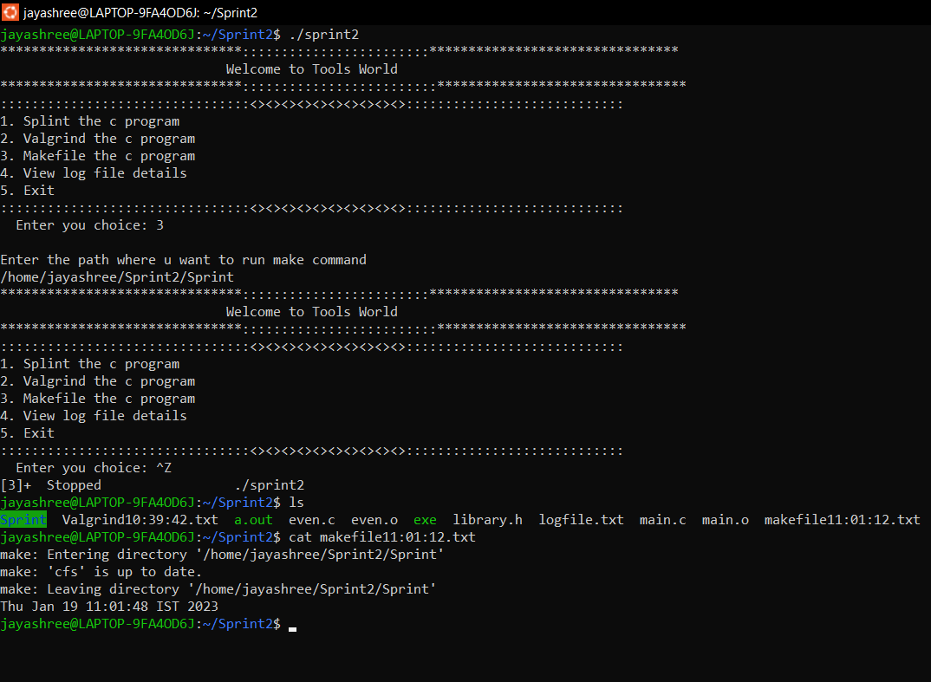
System execute Makefile and capture the Warnings and Errors.

Slide 11
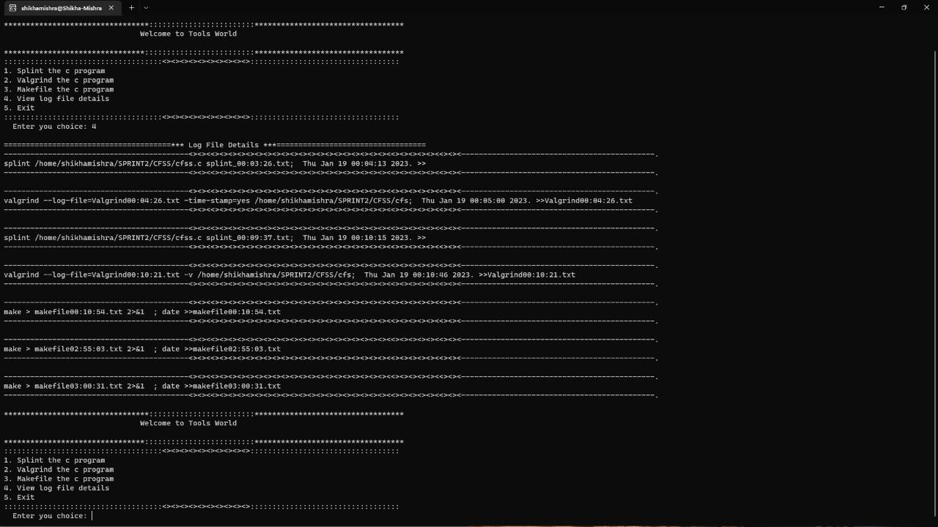
System generates Log file for all the commands with date and timestamp for Splint, Makefile and Valgrind.

Slide 12
Advantages of Static Dynamic Analyzer Tool
--------
Analyze the code without the need for test data.
It find issues that may not be immediately apparent during testing or runtime.
--------
Identify potential issues early in the development process, allowing for easier and cheaper fixes.
Find issues that may not be detectable through static analysis such as race conditions and memory leaks.
---------
Analyze code with real-world test data and in a realistic test environment.
Analyze large codebases quickly and efficiently.
Provides more accurate analysis of code performance and resource usage.

Slide 13
Disadvantages of Static Dynamic Analyzer Tool
--------
It may report issues that are not actually present in the code. This can be frustrating for developers and can lead to unnecessary work in trying to fix non-existent issues.
--------
Static analysis should not be detect runtime behavior or external input.
Dynamic analysis tools can be time-consuming to use, as they require the program to be executed in order to analyze it for large program.
---------
Dynamic analysis tools especially if the program is heavily dependent on external input or has complex control flow.
Both static and dynamic analysis tools can be expensive to purchase and maintain especially for large organizations with many software projects.

Slide 14

Thank You!!!!!!!

